Slide 1
Web Security Threat Detection
Presented by:
K.HEMANTH
(23491F0011)
Under the Guidance of
Amarnathreddy _{M.Tech.,}
‘Assistant professor
Department of master of computer application

Slide 2
ABSTRACT
Web applications play a crucial role in modern society, offering a wide range of services from e-commerce to social networking. However, they are also a common target for cyberattacks due to their complexity and the vast amount of sensitive information they handle. Web vulnerabilities, such as SQL injection, cross-site scripting (XSS), and cross-site request forgery (CSRF), pose significant threats to the security of web applications and their users.This paper provides an overview of common web vulnerabilities, their impact, and current approaches for mitigating them. We discuss the importance of secure coding practices, regular security audits, and the use of security tools and frameworks to protect web applications from potential attacks. Additionally, we explore emerging trends and technologies, such as machine learning and artificial intelligence, that show promise in improving web application security.By understanding the nature of web vulnerabilities and implementing appropriate security measures, developers and organizations can enhance the security posture of their web applications and protect against potential threats.

Slide 3
INTRODUCTION
Web applications play a crucial role in modern society, facilitating various online activities such as e-commerce, social networking, and information sharing. However, the widespread use of web applications also makes them a target for malicious actors seeking to exploit vulnerabilities for nefarious purposes. Web vulnerabilities can lead to data breaches, financial loss, and damage to an organization's reputation.Web vulnerability refers to a weakness or flaw in a web application that can be exploited by attackers to compromise the security of the application or the data it processes. These vulnerabilities can exist at various levels of the web application stack, including the web server, application server, database server, and client-side scripts.
Common web vulnerabilities include SQL injection, cross-site scripting (XSS), cross-site request forgery (CSRF), and insecure direct object references. These vulnerabilities can be exploited to steal sensitive information, modify data, or execute malicious code on the user's device.In recent years, the number and complexity of web vulnerabilities have increased, driven by the growing sophistication of attacks and the rapid evolution of web technologies. As a result, organizations must take proactive measures to identify and mitigate web vulnerabilities to protect their assets and maintain the trust of their users.

Slide 4
Literature Survey
The literature survey on web vulnerabilities reveals a growing concern among researchers and practitioners regarding the security of web applications. Several studies have highlighted the prevalence of web vulnerabilities and their potential impact on the security and privacy of users.
One of the most common web vulnerabilities is SQL injection, where attackers exploit vulnerabilities in web applications to execute malicious SQL queries. A study by Halfond et al. (2006) found that SQL injection was the most common vulnerability in web applications, affecting a large number of websites.
Cross-site scripting (XSS) is another prevalent web vulnerability that allows attackers to inject malicious scripts into web pages viewed by other users. According to research by Huang et al. (2014), XSS attacks are widespread and pose a significant threat to web application security.
Cross-site request forgery (CSRF) is a vulnerability that allows attackers to trick users into performing unintended actions on a website where they are authenticated. A study by Barth et al. (2008) highlighted the prevalence of CSRF vulnerabilities in web applications and the potential for attackers to exploit them.

Slide 5
Literature Surve
In response to these vulnerabilities, researchers have proposed various approaches to mitigate the risk. One approach is to use secure coding practices, such as input validation and output encoding, to prevent vulnerabilities from being introduced into web applications. Another approach is to use automated tools, such as static and dynamic analysis tools, to detect and fix vulnerabilities in existing web applications
Overall, the literature survey indicates that web vulnerabilities continue to be a significant concern for the security community. Researchers and practitioners are actively working to develop effective mitigation strategies to protect web applications from these threats.
A study done by J. Smith, R. Tan "A Comprehensive Study of Web Application Vulnerabilities" in 2020 focuses on Analysis of common web application vulnerabilities, such as SQL Injection (SQLi), Cross-Site Scripting (XSS), and Cross-Site Request Forgery (CSRF) by using the Dataset analysis of 1,000 compromised web applications; root cause identification. And found that 60% of vulnerabilities stem from SQLi and XSS.
A study done by P. Kumar, L. Wang "Machine Learning for Detection of SQL Injection Attacks" in 2021, Focuses on Utilizing supervised machine learning models to detect SQL injection attempts in web applications. With Collected datasets of SQL injection queries and benign inputs; trained models like SVM, Decision Trees, and Neural Networks and found that Neural networks achieved the highest accuracy of 98%.

Slide 6
Literature Survey
A study done by "Dynamic Analysis of Cross-Site Scripting Attacks" in 2019, focused on Dynamic analysis methods to detect XSS vulnerabilities in real-time by Createing a browser extension that simulates attack payloads on user inputs and Detected 90% of XSS vulnerabilities. Reduced false positives compared to static analysis methods.
A study done by "Blockchain for Web Application Security" in 2022, Use of blockchain for securing sensitive data and ensuring transaction integrity in web applications and designed a blockchain-based architecture for e-commerce platforms and found that Improved resistance to SQLi and CSRF attacks with Ensured transparency and immutability of web transactions.
A study done by "Secure Web Application Design Principles" in 2018, focuses on overview of best practices for secure web application development by Conducting a survey of 200 developers and reviewed existing secure coding standards and found Lack of developer awareness about security practices is a major issue.

Slide 7
EXISTING SYSTEM
The existing system for managing web vulnerabilities typically involves a combination of manual code reviews, automated vulnerability scanning tools, and the use of secure coding practices. Manual code reviews are conducted by experienced developers to identify potential vulnerabilities in the source code, such as SQL injection, XSS, and CSRF. While effective, manual reviews can be time-consuming and may not catch all vulnerabilities, especially in large and complex web applications.Automated vulnerability scanning tools are used to detect common vulnerabilities in web applications automatically. These tools can quickly scan a web application for known vulnerabilities and provide a report of issues that need to be addressed. However, automated tools may generate false positives or false negatives, requiring manual verification and validation.Secure coding practices, such as input validation, parameterized queries, and output encoding, are essential for preventing vulnerabilities in web applications.
Developers are encouraged to follow secure coding guidelines and best practices to reduce the risk of introducing vulnerabilities during the development process.

Slide 8
DRAW BACKS
Manual Effort: Manual code reviews are time-consuming and labor-intensive, making them impractical for large-scale web applications or frequent code changes.
Limited Coverage: Automated vulnerability scanning tools may not detect all vulnerabilities, especially those that require complex or context-dependent analysis.

Slide 9
PROPOSED SYSTEM
The proposed system for managing web vulnerabilities aims to address the limitations of the existing system by leveraging advanced technologies and approaches. One key aspect of the proposed system is the integration of automated vulnerability scanning tools with machine learning algorithms. By using machine learning, the system can improve the accuracy of vulnerability detection and reduce false positives and false negatives. Machine learning models can be trained on large datasets of known vulnerabilities to recognize patterns and anomalies in web application code, making them more effective at identifying potential vulnerabilities .Another key component of the proposed system is the use of continuous security testing and monitoring. Rather than relying on periodic scans or manual reviews, the system continuously monitors web applications for vulnerabilities and alerts developers in real-time.
This proactive approach allows vulnerabilities to be identified and addressed promptly, reducing the risk of exploitation.Additionally, the proposed system emphasizes the importance of secure coding practices and developer training. Developers are provided with tools and resources to help them write secure code, such as secure coding guidelines and automated code analysis tools. Regular training sessions and workshops are also conducted to raise awareness about web vulnerabilities and best practices for mitigating them.

Slide 10
ADVANTAGES
Improved Accuracy: By leveraging machine learning, the proposed system can improve the accuracy of vulnerability detection, reducing false positives and false negatives compared to traditional automated tools.
Real-time Monitoring: The proposed system offers real-time monitoring of web applications for vulnerabilities, allowing for prompt detection and mitigation of security issues.
Proactive Approach: Continuous security testing and monitoring enable a proactive approach to managing web vulnerabilities, reducing the risk of exploitation.

Slide 11
SYSTEM REQUIREMENTS
➢ H/W System Configuration:-
➢ Processor - Pentium –IV
➢ RAM - 8 GB (min)
➢ Hard Disk - 20 GB
➢ Key Board - Standard Windows Keyboard
➢ Mouse - Two or Three Button Mouse
➢ Monitor - SVGA

Slide 12
SOFTWARE REQUIREMENTS
Operating system : Windows 7 Ultimate.
Coding Language : Python.
Front-End : Python-3.7.7
Back-End : Django-ORM
Designing : Html, css, javascript.

Slide 13
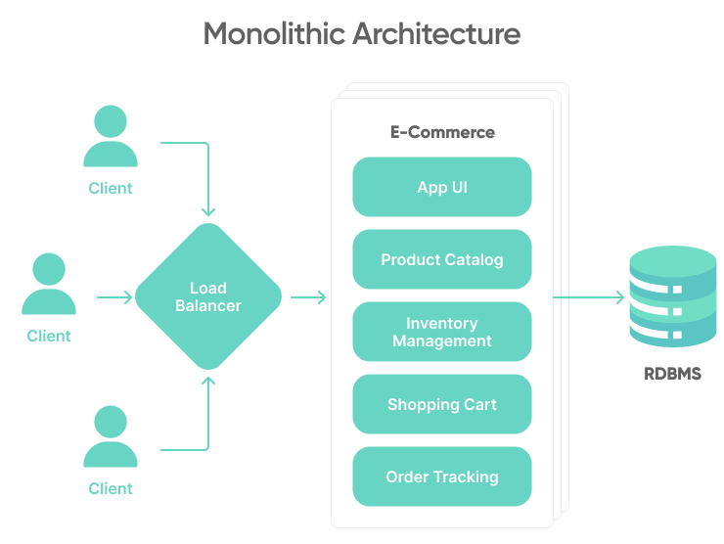
SYSTEM ARCHITECTURE

Slide 14
UML DIAGRAMS
USE CASE DIAGRAM

Slide 15
CLASS DIAGRAM

Slide 16
SEQUENCE DIAGRAM

Slide 17
COLLRABATION DIAGRAM

Slide 18
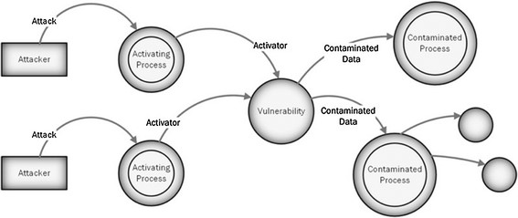
DATA FLOW

Slide 19
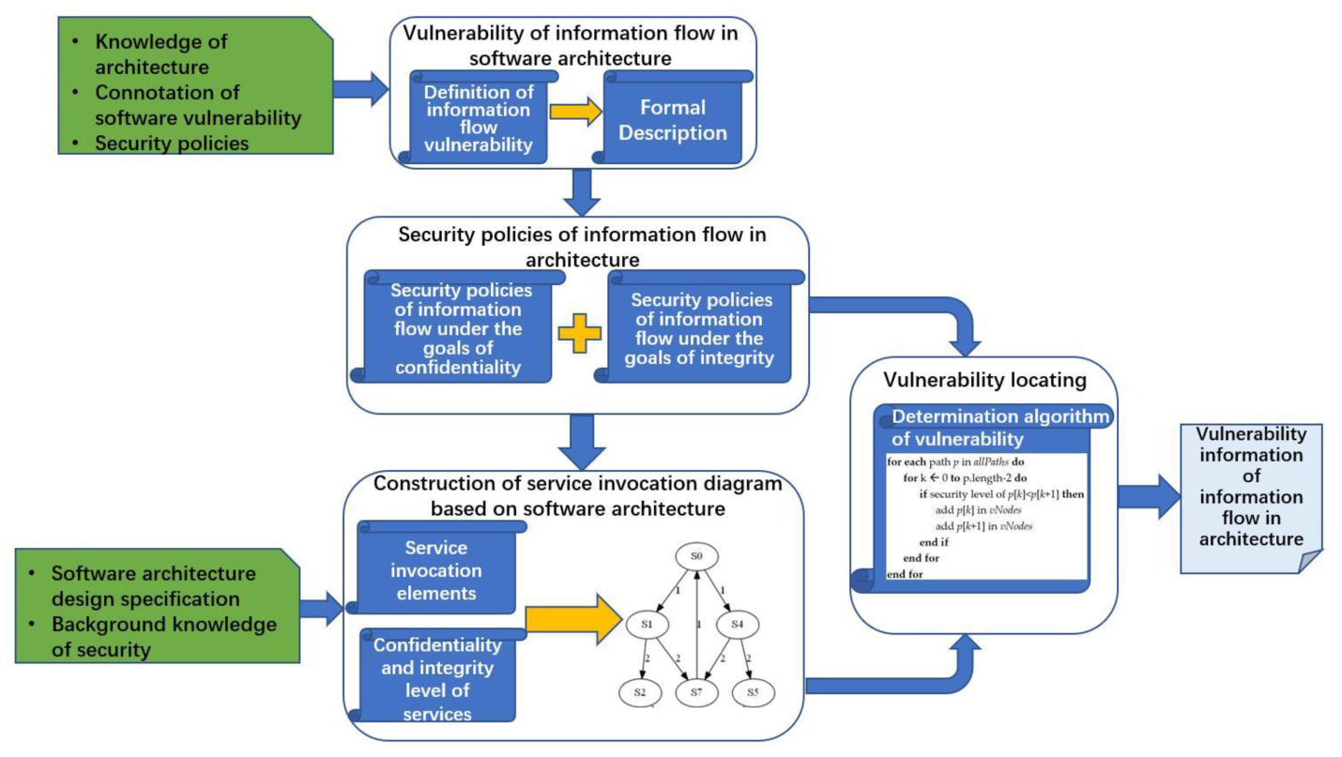
FLOW CHAT

Slide 20
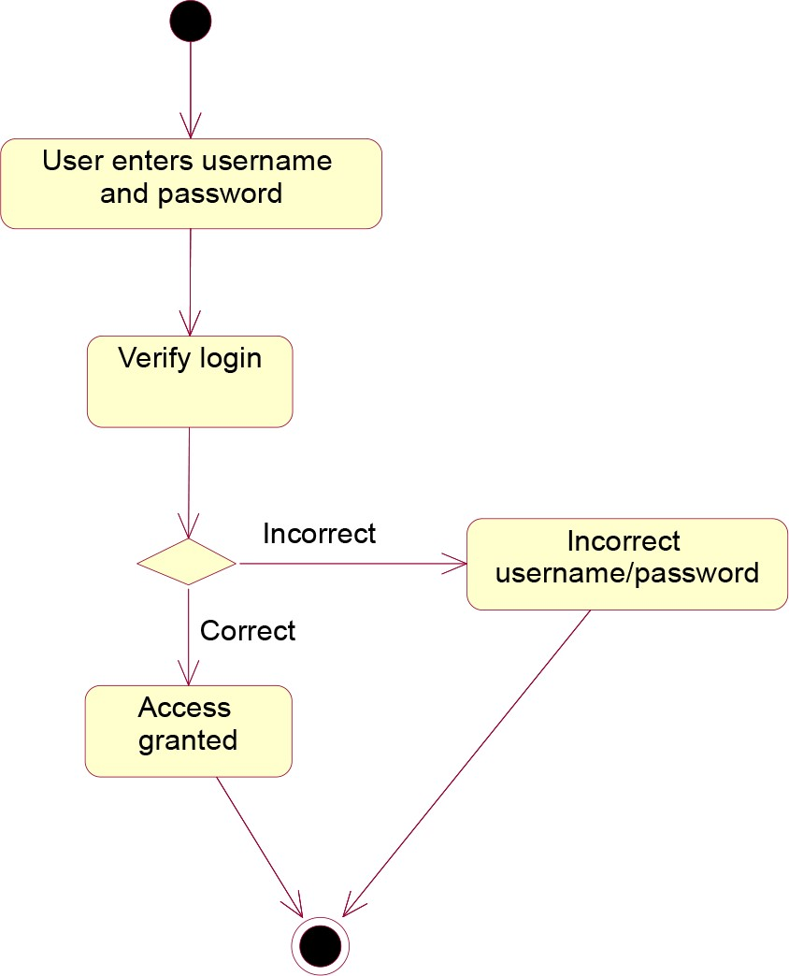
ACTIVITY DIAGRAM

Slide 21
Modules
Tensorflow
TensorFlow is a free and open-source software library for dataflow and differentiable programming across a range of tasks. It is a symbolic math library, and is also used for machine learning applications such as neural networks. It is used for both research and production at Google.‍
TensorFlow was developed by the Google Brain team for internal Google use. It was released under the Apache 2.0 open-source license on November 9, 2015.

Slide 22
Numpy
Numpy is a general-purpose array-processing package. It provides a high-performance multidimensional array object, and tools for working with these arrays.
It is the fundamental package for scientific computing with Python. It contains various features including these important ones:
A powerful N-dimensional array object
Sophisticated (broadcasting) functions
Tools for integrating C/C++ and Fortran code
Useful linear algebra, Fourier transform, and random number capabilities
Besides its obvious scientific uses, Numpy can also be used as an efficient multi-dimensional container of generic data. Arbitrary data-types can be defined using Numpy which allows Numpy to seamlessly and speedily integrate with a wide variety of databases.

Slide 23
Pandas
Pandas is an open-source Python Library providing high-performance data manipulation and analysis tool using its powerful data structures. Python was majorly used for data munging and preparation. It had very little contribution towards data analysis. Pandas solved this problem. Using Pandas, we can accomplish five typical steps in the processing and analysis of data, regardless of the origin of data load, prepare, manipulate, model, and analyze. Python with Pandas is used in a wide range of fields including academic and commercial domains including finance, economics, Statistics, analytics, etc.

Slide 24
Matplotlib
Matplotlib is a Python 2D plotting library which produces publication quality figures in a variety of hardcopy formats and interactive environments across platforms. Matplotlib can be used in Python scripts, the Python and IPython shells, the Jupyter Notebook, web application servers, and four graphical user interface toolkits. Matplotlib tries to make easy things easy and hard things possible. You can generate plots, histograms, power spectra, bar charts, error charts, scatter plots, etc., with just a few lines of code. For examples, see the sample plots and thumbnail gallery.
For simple plotting the pyplot module provides a MATLAB-like interface, particularly when combined with IPython. For the power user, you have full control of line styles, font properties, axes properties, etc, via an object oriented interface or via a set of functions familiar to MATLAB users.

Slide 25
CONLUSION
In conclusion, web vulnerabilities pose a significant threat to the security and integrity of web applications. Common vulnerabilities such as SQL injection, cross-site scripting (XSS), and cross-site request forgery (CSRF) can be exploited by attackers to steal sensitive information, modify data, or execute malicious code. To mitigate these vulnerabilities, organizations should implement secure coding practices, such as input validation and output encoding, to prevent vulnerabilities from being introduced into web applications. Additionally, the use of automated tools for vulnerability detection and regular security audits can help identify and address vulnerabilities in existing web applications.It is crucial for organizations to stay vigilant and proactive in addressing web vulnerabilities, as the threat landscape continues to evolve. By taking proactive measures to secure their web applications, organizations can reduce the risk of exploitation and protect their assets and reputation.

Slide 26
References
Halfond, W. G., Orso, A., & Manolios, P. (2006). AMNESIA: Analysis and Monitoring for Neutralizing SQL-Injection Attacks. Proceedings of the 20th IEEE/ACM International Conference on Automated Software Engineering (ASE'06), pp. 174–183.
Huang, Y., Huang, C., Su, S., & Lee, J. (2014). A Survey on Web Application Security. Journal of Software, 9(1), 218–228.
Barth, A., Jackson, C., & Mitchell, J. C. (2008). Robust Defenses for Cross-Site Request Forgery. Proceedings of the 15th ACM Conference on Computer and Communications Security (CCS ’08), pp. 75–88.
Williams, J., & Wichers, D. (2006). OWASP Top Ten Project. OWASP Foundation. Retrieved from: https://owasp.org
Musch, M., Wachtel, A., Johns, M., & Rieck, K. (2018). A Survey on Web Application Vulnerability Detection Tools. IEEE Communications Surveys & Tutorials, 21(3), 1413–1435.
Fonseca, J., Vieira, M., & Madeira, H. (2007). Testing and Comparing Web Vulnerability Scanning Tools for SQL Injection and XSS Attacks. Proceedings of the 13th Pacific Rim International Symposium on Dependable Computing, pp. 365–372.

Slide 27
Antunes, N., & Vieira, M. (2015). Comparing the Effectiveness of Penetration Testing and Static Code Analysis. IEEE Transactions on Dependable and Secure Computing, 14(3), 1–14.
Doupe, A., Cova, M., & Vigna, G. (2010). Wepawet: An Automated Web Exploit Detection System for JavaScript. Proceedings of the 20th International Conference on World Wide Web (WWW ’10), pp. 635–644.
Li, Y., Tan, L., Wang, X., & Lu, S. (2011). Parameterized Unit Testing for Web Security. Proceedings of the 33rd International Conference on Software Engineering (ICSE ’11), pp. 901–910.
Python Software Foundation. (2023). Python Programming Language – Official Documentation. Retrieved from: https://www.python.org
TensorFlow Developers. (2023). TensorFlow: An Open Source Machine Learning Framework. Retrieved from: https://www.tensorflow.org
Scikit-learn Developers. (2023). Scikit-learn: Machine Learning in Python. Retrieved from: https://scikit-learn.org/stable/
GeeksforGeeks. (2023). Software Development Life Cycle (SDLC) – Models, Types, Phases. Retrieved from: https://www.geeksforgeeks.org/sdlc-models-types-phases-use

Slide 28
THANK YOU

